Slide 1
Deep Neural Networks
What does this
have to do with
the brain?

Slide 2



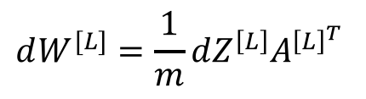

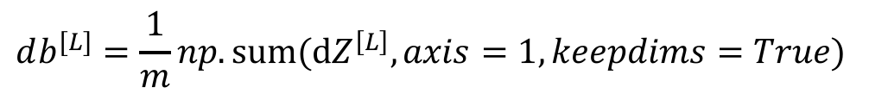




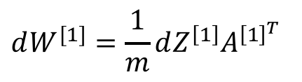
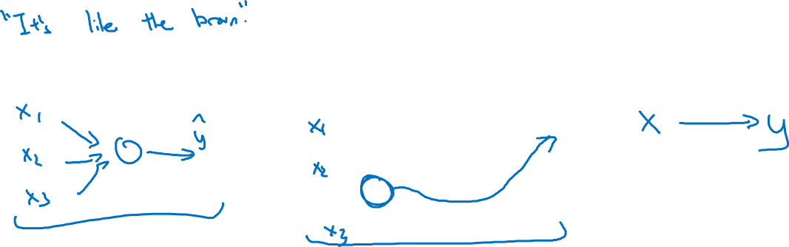
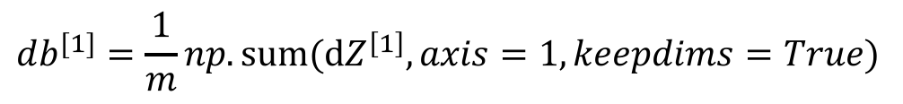
Forward and backward propagation
For example the first activation functions could be ReLU and the last one
Could be sigmoid
…
…
Align left/vertical will mess up the equations here

